Slide 1

Machine Learning Model Deployment with IBM Cloud Watson Studio
By
gobika.r
Gomathi . M
hemamalini . S
janarthini . S
Jayasri . s

Slide 2
Problem Statement
Become a wizard of predictive analytics with IBM Cloud Watson Studio. Train machine learning models to predict outcomes in real-time. Deploy the models as web services and integrate them into your applications. Unlock the magic of data-driven insights and make informed decisions like never before!
The project involves training a machine learning model using IBM Cloud Watson Studio and deploying it as a web service. The goal is to become proficient in predictive analytics by creating a model that can predict outcomes in real-time. The project encompasses defining the predictive use case, selecting a suitable dataset, training a machine learning model , deploying the model as a web service, and integrating it into applications.

Slide 3

Design Thinking
Predictive Use Case
Define a use case for predictive analytics, such as predicting customer churn or product demand.

Slide 4

Design Thinking
Dataset Selection
Choose a relevant dataset to train the machine learning model.

Slide 5
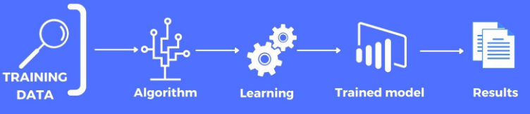
Design Thinking
Model Training
Select a suitable machine learning algorithm and train the model using IBM Cloud Watson Studio.

Slide 6
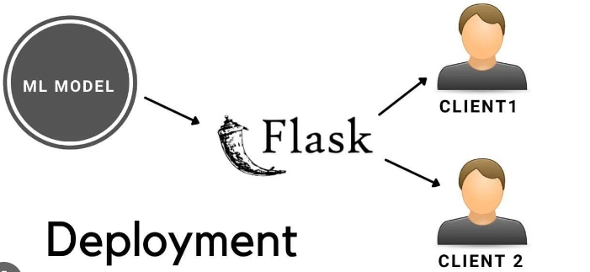
Design Thinking
Model Deployment
Deploy the trained model as a web service using IBM Cloud Watson Studio's deployment capabilities.

Slide 7

Design Thinking
Integration
Integrate the deployed model into applications or systems to make real time predictions.

Slide 8
THANK YOU

